Slide 1

Digital Fundamentals
Tenth Edition
Floyd
Chapter 8
© 2008 Pearson Education

Slide 2
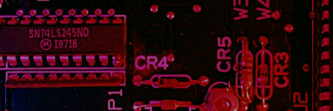
Summary
Counters
A counter is a register that goes through a predetermined sequence of states upon the application of clock pulses.
Counters are categorized as:
Asynchronous counter(Ripple Counters): The FF output transition serves as a source for triggering other FFs. No common clock.
Synchronous Counter: All FFs receive the common clock pulse, and the change of state is determined from the present state.
Notes:
能够记忆输入脉冲个数的电路称为计数器。它在时钟脉冲的作用下，根据预定义的状态序列完成计数。
分类：
异步计数器（也称行波计数器）
无共同时钟，触发器的输出转换作为其他触发器的触发来源。
同步计数器
有共同时钟，所有触发器接受公共时钟脉冲，状态的改变由现态决定。

Slide 3
Summary
Counting in Binary
As you know, the binary count sequence follows a familiar pattern of 0’s and 1’s as described in Section 2-2 of the text.
0 0 0
0 0 1
0 1 0
0 1 1
1 0 0
1 0 1
1 1 0
1 1 1
LSB changes on every number.
The next bit changes on every other number.
The next bit changes on every fourth number.

Slide 4
Summary
Counting in Binary
A counter can form the same pattern of 0’s and 1’s with logic levels. The first stage in the counter represents the least significant bit – notice that these waveforms follow the same pattern as counting in binary.
LSB
MSB
Notes:
如果最低有效位为Q₀，最高有效位为Q₂，观察变化
最低有效位Q₀每次都变化
每次Q₀从1变0时，Q₁发生变化。
每次Q₁从1变0时，Q₂发生变化。

Slide 5
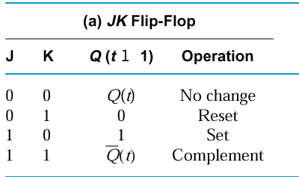
Summary
Three bit Asynchronous Counter(三位异步计数器)
In an asynchronous counter, the clock is applied only to the first stage. Subsequent stages derive the clock from the previous stage.
The three-bit asynchronous counter shown is typical. It uses J-K flip-flops in the toggle mode.
HIGH
J₀
Q₀
J₁
Q₁
J₂
Q₂
CLK
C
C
C
Q₀
Q₁
K₀
K₁
K₂
Waveforms are on the following slide…
Notes:
首先，注意到触发器都是JK，且为上升沿触发模式。
当J、K都为1时，触发器处于翻转模式。
在异步计数器里，时钟只连接第一个计数器，后续的计数器使用前一个计数器的输出来触发。
也即较低有效位输出作为下一个较高有效位的时钟信号
注意：连接Q’的作用在于，当Q从1变成0时，Q’刚好处于从0变1.
在以后的触发器电路中，如果没有特别说明，Q₀总会是最低一位。

Slide 6
Summary
Three bit Asynchronous Counter
Notice that the Q₀ output is triggered on the leading edge of the clock signal. The following stage is triggered from Q₀. The leading edge of Q₀ is equivalent to the trailing edge of Q₀. The resulting sequence is that of an 3-bit binary up counter.
CLK
Q₀
Q₁
Q₂
Notes:
思考：如果把上升沿触发的JK触发器换成下降沿触发的JK触发器，设计上需要如何改动？
答案：从连接Q’变成连接Q。

Slide 7
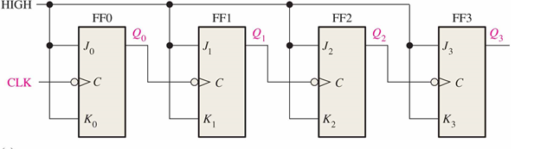
Four bit Asynchronous Counter
A 4-bit Upward Counting Ripple Counter with negative edge-triggered J-K flip-flop:
Counting from 0000~1111
How about 5-bit? 6-bit?
Notes:
注意：
JK输入都是逻辑1
时钟脉冲是负脉冲有效
每个Q输出作为下一级的时钟脉冲。最低级直接接入时钟脉冲
（依次类推，理论上可设计出任意N bit的异步计数器，可以计数从0到2^{N}-1。）

Slide 8
Summary
Propagation Delay(传输延迟)*
Asynchronous counters are sometimes called ripple counters, because the stages do not all change together. For certain applications requiring high clock rates, this is a major disadvantage.
Notice how delays are cumulative as each stage in a counter is clocked later than the previous stage.
CLK
Q₀
Q₁
Q₂
Q₀ is delayed by 1 propagation delay, Q₂ by 2 delays and Q₃ by 3 delays.
Notes:
异步计数器，有时候也称行波计数器。
触发不是立即传递达到，而是有一个延时。异步计数器的这种积累延迟，在许多应用中都是一个主要的缺点，因为它限制了计数器的运行速度，并且产生了译码问题。计数器中的最大积累延迟必须小于时钟波形的周期。

Slide 9
Summary
Modulus-N Counters
The modulus of a counter is the number of unique states through which the counter will sequence.
计数器的模是计数器按顺序经过的独特状态的数目。
The maximum possible number of states (maximum modulus) of a counter is 2^{n}, where n is the number of flip-flops in the counter.
包含n个触发器的计数器的最大可能状态是2^{n}。

Slide 10
Summary
Asynchronous Decade Counter(异步十进制计数器)
This counter uses partial decoding to recycle the count sequence to zero after the 1001 state. The flip-flops are trailing-edge triggered, so clocks are derived from the Q outputs. Other truncated sequences(截断序列) can be obtained using a similar technique.
CLR
HIGH
Q₀
Q₁
Q₂
Q₃
J₀
J₁
J₂
J₃
CLK
C
C
C
C
K₀
K₁
K₂
K₃
Notes:
截断序列：设计计数器，使得其序列中的状态个数小于最大值2^{n}。这种序列称为截断序列。
只要是有10个状态的都可以称为模10计数器。按照0000~1001排序的称为BCD模10计数器。
Decade:10个一组

Slide 11
WHY？
HIGH
Q₀
Q₁
Q₂
Q₃
J₀
J₁
J₂
J₃
CLK
C
C
C
C
K₀
K₁
K₂
K₃
One way to truncate the sequence is to decode ten (1010) with an active-low output.
Partial Decoding(部分译码): the two unique states(Q1=1 and Q3=1) are sufficient to decode the count of ten.（Verify it with K-map)
Notes:
设计原理：在数完0到9以后，数到10的瞬间给出一个低信号到CLR端上，则所有计数器清0.
一种最容易想到的办法就是，设计一个1010（10）的译码器，采用4输入与非门。
但是，进一步考虑到序列的特殊性，从0000到1001，都不会同时在Q1和Q3上具有高电平，所以可以采用部分译码的形式，只使用一个二输入与非门即可。
用卡诺图也可以验证，其中0~9要求输出1，1010要求输出0，其余为任意项。则可推出Q₃’+Q₁’
类似的设计方法可以推任意模的计数器。

Slide 12
Summary
Asynchronous Decade Counter
When Q₁ and Q₃ are HIGH together, the counter is cleared by a “glitch(毛刺)” on the CLR line.
CLK
Q₀
Q₁
Glitch
Q₂
Q₃
CLR
Glitch

Slide 13
Quick design a asynchronous module-K counter:
Counting from 0 to K-1
1. Choose the type of flip-flops.
2. Decide the number of flip-flops: 2^{n-1} < K ≤ 2^{n}
3. Let all the flip-flops recycle back to 0 after the K-1 state.
K=2^{n}.
K<2^{n}. One way to make it is to decode K with logic gates and connect the output to the clear inputs of the flip-flops.
D
Q
Verify it with Example 8-2 P.313
CLK
CLK
Q
Notes:
当然，设计的时候，要留意用的是JK触发器，还是D触发器。上升沿还是下降沿。
回忆：D计数器，如何实现翻转功能？
把Q’接到D上即可。

Slide 14
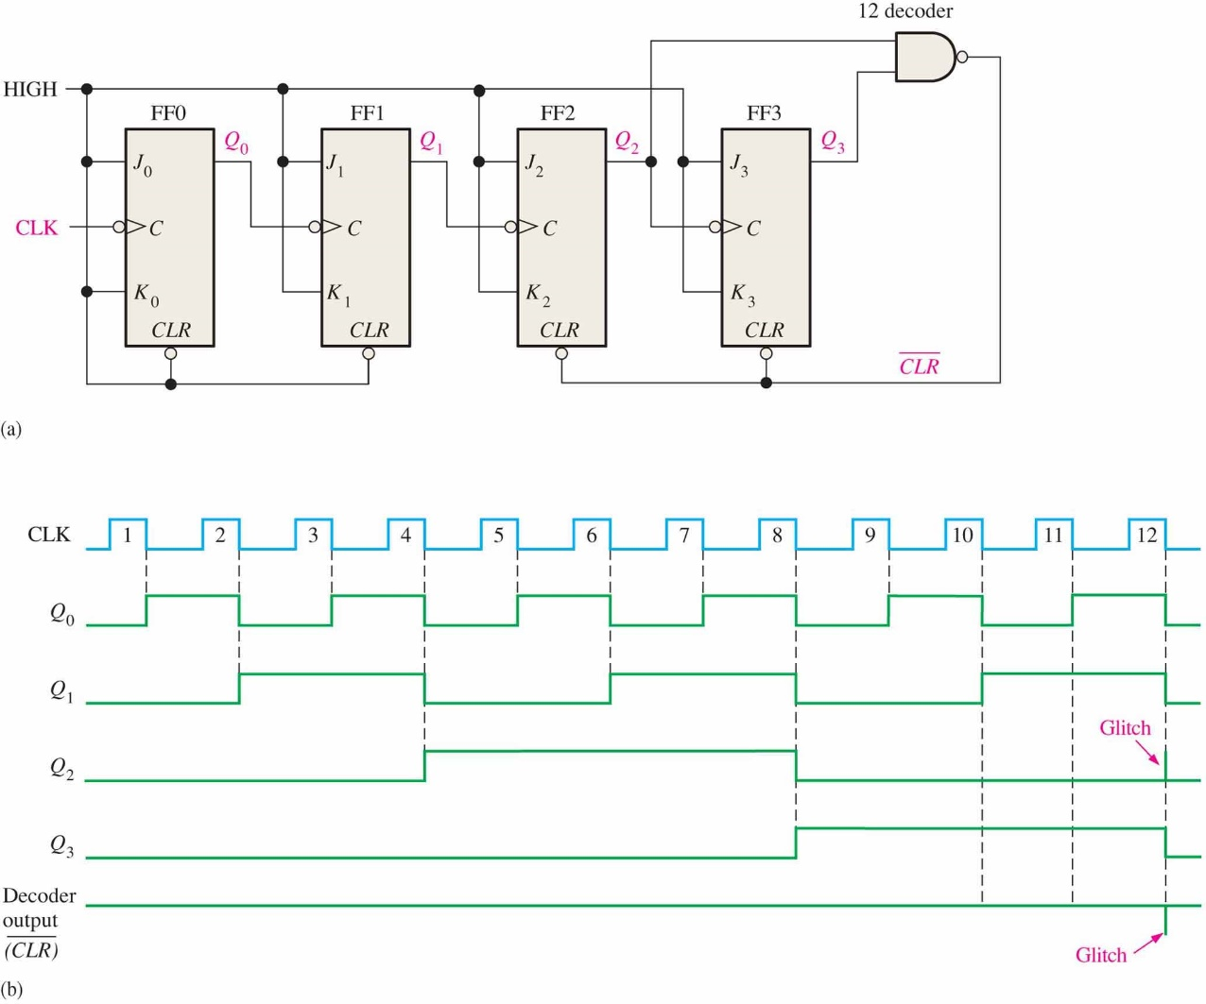
Figure 8.7 Asynchronously clocked modulus-12 counter with asynchronous recycling.
EXAMPLE 8–2
how an asynchronous counter with J-K flip-flops can be implemented having a modulus of twelve with a straight binary sequence from 0000 through 1011.
Since three flip-flops can produce a maximum of eight states, four flip-flops are required to produce any modulus greater
than eight but less than or equal to sixteen.
When the counter gets to its last state, 1011, it must recycle back to 0000 rather than going to its normal next state of 1100, as illustrated in the following sequence chart:
Normal next state
Observe that Q0 and Q1 both go to 0 anyway, but Q2 and Q3 must be forced to 0 on the twelfth clock pulse. Figure 8–7
shows the modulus-12 counter. The NAND gate partially decodes count twelve (1100) and resets flip-flop 2 and flip-flop 3.

Slide 15
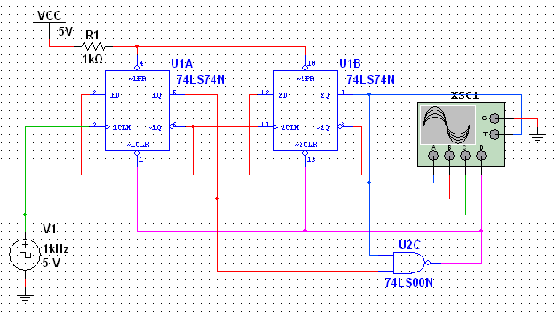
Summary
Asynchronous Counter Using D Flip-flops*
D flip-flops can be set to toggle and used as asynchronous counters by connecting Q back to D. The counter in this slide is a Multisim simulation of one described in the lab manual. Can you figure out the sequence?
LSB
MSB
Q to D puts D flip-flop in toggle mode
The next slide shows the scope…

Slide 16
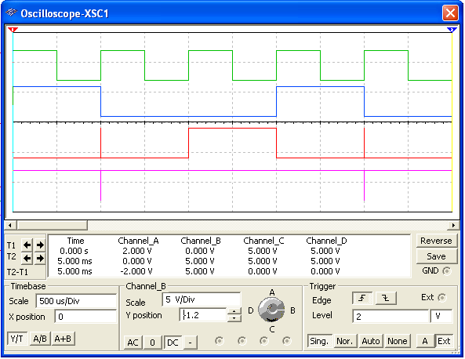
Summary
CLK
LSB
MSB
CLR
Note that it is momentarily in state 3 which causes it to clear.
The sequence is 0 – 2 – 1 – (CLR) (repeat)…

Slide 17
Summary
The 74LS93A Asynchronous Counter
The 74LS93A has one independent toggle J-K flip-flop driven by CLK A and three toggle J-K flip-flops that form an asynchronous counter driven by CLK B.
The counter can be extended to form a 4-bit counter by connecting Q₀ to the CLK B input. Two inputs are provided that clear the count.
CLK B
J₀
J₁
J₂
J₃
CLK A
C
C
C
C
K₀
K₁
K₂
K₃
All J and K inputs are connected internally HIGH
RO (1)
RO (2)
Q₀
Q₁
Q₂
Q₃
Notes:
负边沿触发。
所有JK都接高电平，也即采用了翻转模式。
两个时钟信号。
当RO1和RO2都为高时，则所有计数器清0.
如果把Q0和CLK B连接，则构成一个4位模16计数器。
74LS93A，可以实现所有模16以内的计数器。

Slide 18
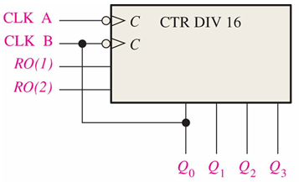
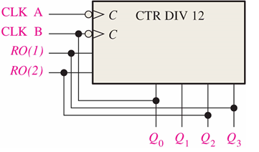
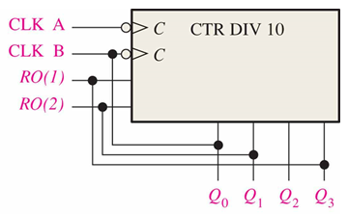
How to design modulus-N counter with 74LS93？
{N=2..16}

Slide 19
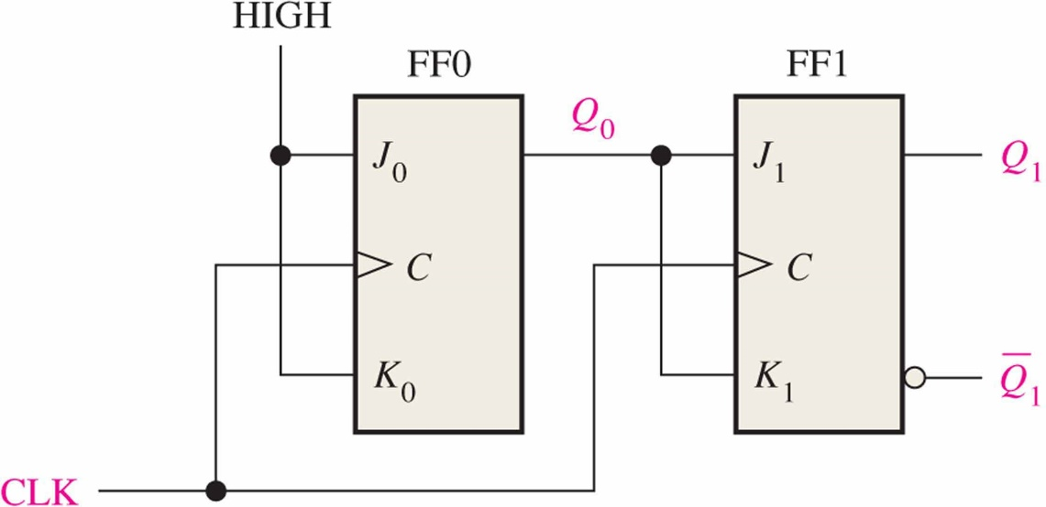
Summary
8.2 Synchronous Counters(同步计数器)
In a synchronous counter all flip-flops are clocked together with a common clock pulse. Synchronous counters overcome the disadvantage of accumulated propagation delays, but generally they require more circuitry to control states changes.
A 2-bit synchronous binary counter
Notes:
JK触发器
上升沿触发，且接入公共时钟信号
高级触发器的J-K输入由低级触发器决定。

Slide 20
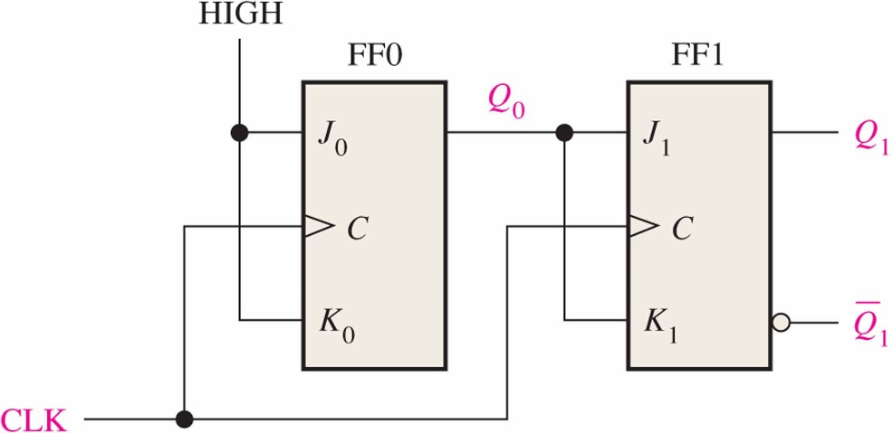
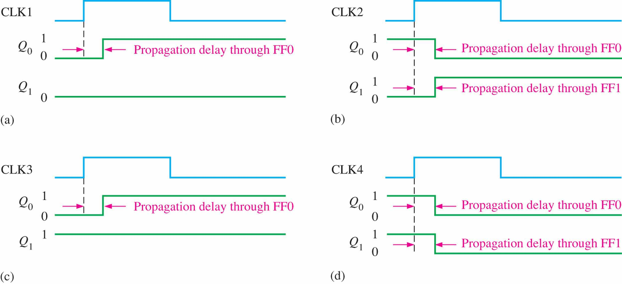
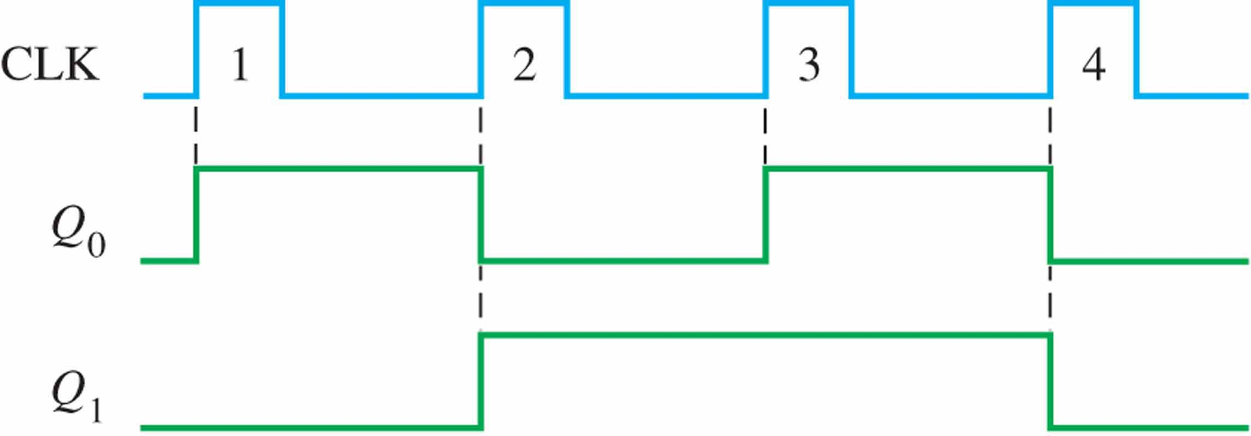
Timing details for the 2-bit synchronous counter
Notes:
实际绘图时，延时会被忽略。

Slide 21
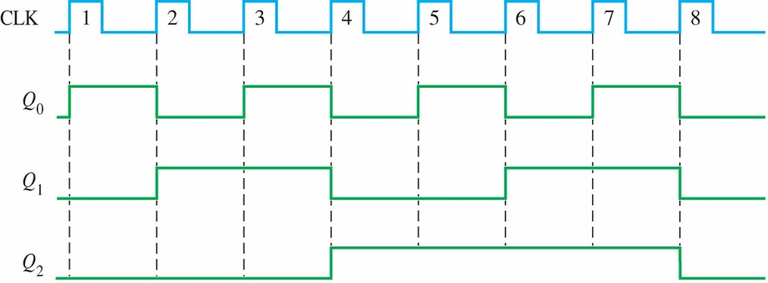
Summary
A 3-bit binary Synchronous Counters(三位同步计数器)
This 3-bit binary synchronous counter has the same count sequence as the 3-bit asynchronous counter shown previously.
HIGH
Q₀
Q₀
Q₁
Q₀Q₁
Q₂
J₀
J₁
J₂
C
C
C
K₀
K₁
K₂
CLK
The next slide shows how to analyze this counter by writing the logic equations for each input. Notice the inputs to each flip-flop…
Notes:
考虑变化情况，011转100，以及111转000，可知当Q0Q1同时为1时，下一步，Q2发生变化。

Slide 22
Summary
Analysis of Synchronous Counters
A tabular technique for analysis is illustrated for the counter on the previous slide. Start by setting up the outputs as shown, then write the logic equation for each input. This has been done for the counter.
1. Put the counter in an arbitrary state; then determine the inputs for this state.
2. Use the new inputs to determine the next state: Q₂ and Q₁ will latch and Q₀ will toggle.
3. Set up the next group of inputs from the current output.
Outputs
Logic for inputs
Q₂ Q₁ Q₀ | J₂ = Q₀Q₁ | K₂ = Q₀Q₁ | J₁ = Q₀ | K₁ = Q₀ | J₀ = 1 | K₀ = 1
0 0 0
0
0
0
0
1
1
0 0 1
0
0
1
1
1
1
0 1 0
4. Q₂ will latch again but both Q₁ and Q₀ will toggle.
Continue like this, to complete the table. The next slide shows the completed table…

Slide 23
Summary
Analysis of Synchronous Counters
Outputs
Logic for inputs
Q₂ Q₁ Q₀ | J₂ = Q₀Q₁ | K₂ = Q₀Q₁ | J₁ = Q₀ | K₁ = Q₀ | J₀ = 1 | K₀ = 1
0 0 0
0
0
0
0
1
1
0 0 1
0
0
1
1
1
1
0 1 0
0
0
0
0
1
1
0 1 1
1
1
1
1
1
1
1 0 0
0
0
0
0
1
1
1 0 1
0
0
1
1
1
1
1 1 0
0
0
0
0
1
1
1 1 1
1
1
1
1
1
1
0 0 0
At this points all states have been accounted for and the counter is ready to recycle…

Slide 24
Summary
A 4-bit Synchronous Binary Counter
The 4-bit binary counter has one more AND gate than the 3-bit counter just described. The shaded areas show where the AND gate outputs are HIGH causing the next FF to toggle.
Q₀
Q₁
Q₂
Q₃

Slide 25
Sequential Circuits’ design

Slide 26
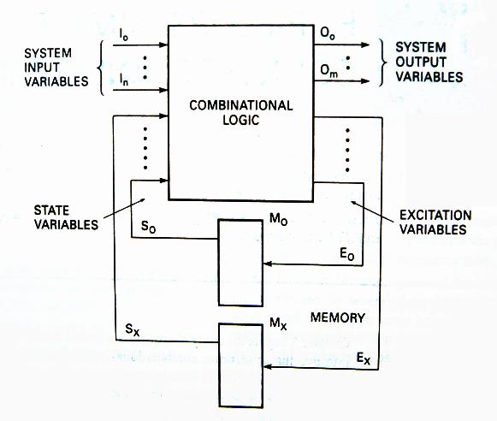
Sequential Circuit Models(时序电路模型)
输出方程
O=f₁(I,S)
状态方程
S_{t+1}=f₃(E,S_{t})
激励方程
E=f₂(I,S)
电路存在反馈
存储元件：数据随时间自由变化

Slide 27
Mealy Vs Moore machines(Mealy & Moore机)
Mealy model:
Both outputs and next state depend both on primary inputs AND present state.
Moore model:
Only next state depends directly on primary inputs AND present state. Outputs depend only on present state.
O=g(I,S_{t})
O=g(S_{t})
Notes:
Mealy模型
输出以及次态由输入和现态决定
Moore模型
次态由输入和现态决定，而输出只取决于现态。

Slide 28
State Machine Notation(状态机符号)
Imput variable
Output variable
State variable
Excitation variable
State
State variables and states are related by the expression:
2^{x}=y
State variables
states
Notes:
输入变量(Input variable)
源于时序机外部的所有变量
输出变量(Output variable)
离开时序机的所有变量
状态变量(State variable)
触发器输出
激励变量(Excitation variable）
触发器输入
状态(State)
由存储元件的内容来定义
状态变量与状态个数的关系： 2^{x}=y
x：状态变量的个数
y：状态个数

Slide 29
State Diagram (状态图)
Graphical representation of a state table.
Graph node with label s denotes state s
D触发器状态转换图
D=1
D=1
D=0
0
1
S
D=0
Graph edge with label X denotes transition between two states when input X is applied
X
Notes:
时序电路的图形化表示法
状态图中带标签S的圆形节点表示状态S。
两个状态间的，带标签的有向边表示，当标签所示条件发生时，两个状态间的转移情况。

Slide 30
State Diagram of Mealy model
0/0
1/0
I/O
00
01
S1
S2
0/1
Reads as: When at state s1 and apply input I, we get output O and proceed to state s2.
当现态为S1，输入I，则机器将转换到状态S2，输出O。
0/1
0/1
1/0
10
1/0
11
1/0

Slide 31
State Diagram of Moore model
I
00,11
S1/O1
S2/O2
01,10
0/0
1/1
Reads as: When at state s1 with output
O1 and apply input I,
we proceed to state s2 with
Output O2.
01,10
00,11
Notes:
当现态为S1，输出为O1，输入I，则转换到S2状态，并输出O2。

Slide 32
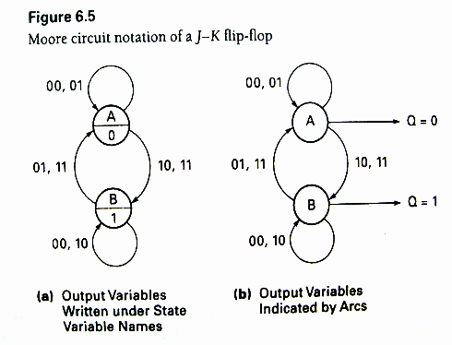
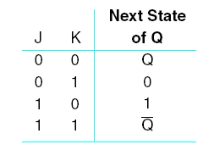
State Diagram
Notes:
J-K触发器的两种Moore电路表示法
(a)输出变量写在状态变量名的下面
(b)用弧线表示的输出变量

Slide 33
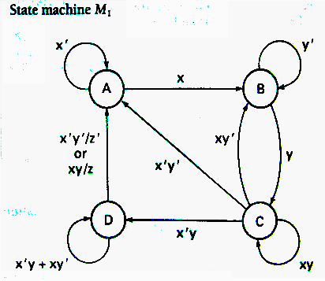
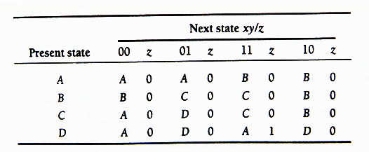
State Table（状态表）
Enumerates the relationship between inputs, outputs, and states of the sequential circuit.
State Table
Notes:
状态图的表状形式。列出了时序电路的输入、输出以及状态之间的关系。
右上角图中，只指出了z为真的情况

Slide 34
State Table
State Table
Notes:
状态和触发器之间如何关联起来？通过状态转换表
先使用状态表的好处？设计完状态流程以前，并不能确定需要几个触发器。

Slide 35
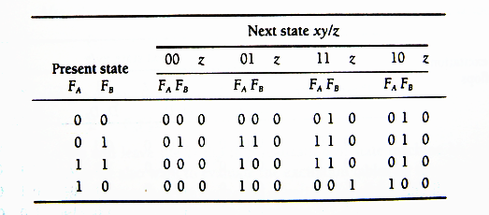
Transition Table(状态转换表)
Each state is assigned a unique code.
F_{A} | F_{B} | State
0 | 0 | A
0 | 1 | B
1 | 1 | C
1 | 0 | D
Notes:
将特定的状态变量值分配给每一状态。
此处四个状态，2²=4，需要2个触发器。

Slide 36
Transition Table
Transition Table for state machine M₁
Transition Table for state machine M₁

Slide 37
Excitation Table and Equations (激励表与激励函数)
Choose the type of flip-flops to design the state machine.
D
JK
SR

Slide 38
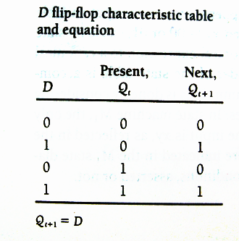
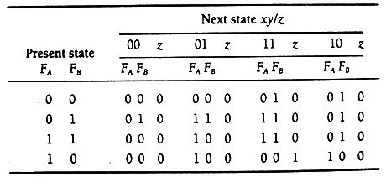
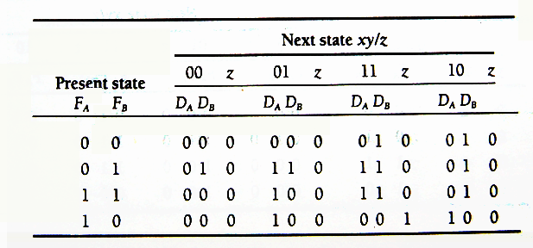
Excitation Table and Equations
D flip-flop used to realize circuit (two D flip-flops)
Transition Table for state machine M₁
state machine M₁ excitation table using D flip-flops

Slide 39
Excitation Table and Equations
D flip-flop used to realize circuit (two D flip-flops)
Transition Table for state machine M₁
How to get the equations？
D_{A}
D_{B}
Z
state machine M₁ excitation table using D flip-flops

Slide 40
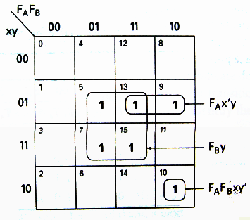
Excitation Table and Equations
D_{A}=f(F_{A},F_{B},x,y)=Σ(5,7,10,13,15)=F_{A}F_{B}’xy’+F_{A}x’y+F_{B}y
D_{A} K-Map

Slide 41
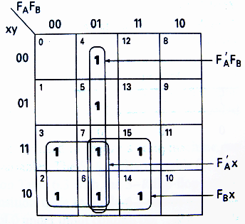
Excitation Table and Equations
D_{B}=f(F_{A},F_{B},x,y)
=Σ(2,3,4,5,6,7,14,15)
=F_{A}’F_{B}+F_{A}’x+F_{B}x
D_{B} K-Map

Slide 42
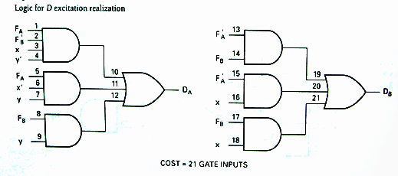
Excitation Table and Equations
Z= f(F_{A},F_{B},x,y)=Σ(11)
=F_{A}F_{B}’xy
D_{A}=F_{A}F_{B}’xy’+F_{A}x’y+F_{B}y
D_{B}=F_{A}’F_{B}+F_{A}’x+F_{B}x
Notes:
激励实现的代价：21条逻辑门输入线。

Slide 43
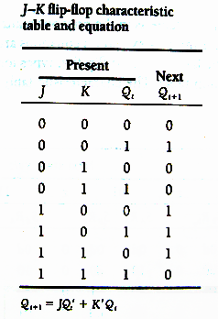
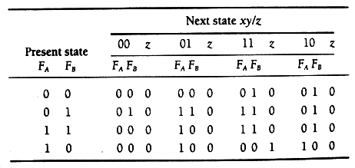
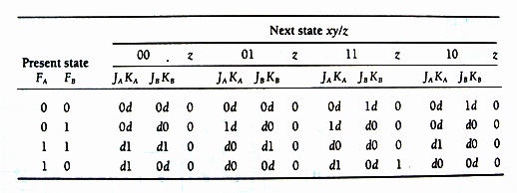
Excitation Table and Equations
J-K flip-flop used to realize circuit (two J-K flip-flops)
Transition Table for state machine M₁
state machine M₁ excitation table using J-K flip-flops

Slide 44
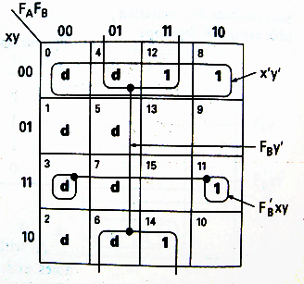
Excitation Table and Equations
J_{A}=f(F_{A},F_{B},x,y)
=Σ(5,7) +Σd(8,9,10,11,12,13,14,15)
=F_{B}y
K_{A}=f(F_{A},F_{B},x,y)
=Σ(8,11,12,14) +Σd(0,1,2,3,4,6,7) =F_{B}’xy+x’y’+F_{B}y’
J_{A} K-Map
K_{A} K-Map

Slide 45
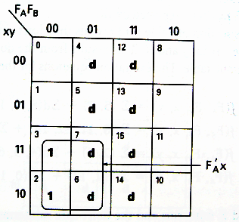
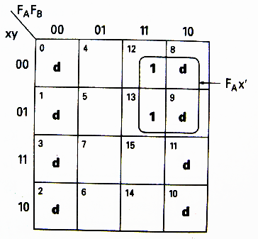
Excitation Table and Equations
Z= f(F_{A},F_{B},x,y)=Σ(11)
=F_{A}F_{B}’xy
J_{B}=f(F_{A},F_{B},x,y)
=Σ(2,3) +Σd(4,5,6,7,12,13,14,15) =F_{A}’x
K_{B}=f(F_{A},F_{B},x,y)
=Σ(12,13) +Σd(0,1,2,3,8,9,10,11) =F_{A}x’
J_{B} K-Map
K_{B} K-Map
Notes:
Z只和触发器输出状态以及输入有关，和所选择的触发器类型无关。故布尔表达式不变。

Slide 46
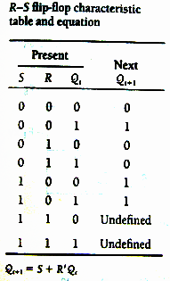
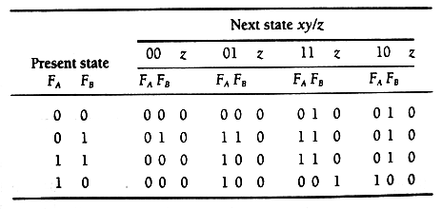
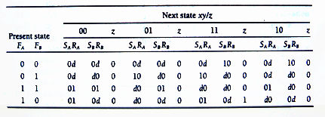
Excitation Table and Equations
S-R flip-flop used to realize circuit (two SR flip-flops)
Transition Table for state machine M₁
state machine M₁ excitation table using S-R flip-flops

Slide 47
Excitation Table and Equations
S_{A}=f(F_{A},F_{B},x,y)
=Σ(5,7) +Σd(9,10,13,15) =F_{B}y
R_{A}=f(F_{A},F_{B},x,y)
=Σ(8,11,12,14) +Σd(0,1,2,3,4,6) =F_{B}’xy+x’y’+F_{B}y’
S_{A} K-Map
R_{A} K-Map

Slide 48
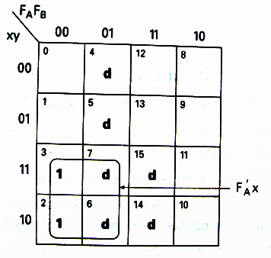
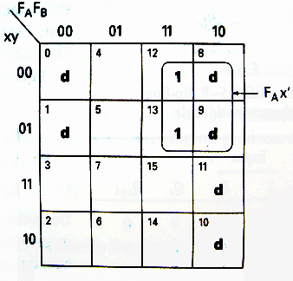
Excitation Table and Equations
S_{B}=f(F_{A},F_{B},x,y)
=Σ(2,3) +Σd(4,5,6,7,14,15) =F_{A}’x
R_{B}=f(F_{A},F_{B},x,y)
=Σ(12,13) +Σd(0,1,8,9,10,11) =F_{A}x’
S_{B} K-Map
R_{B} K-Map

Slide 49
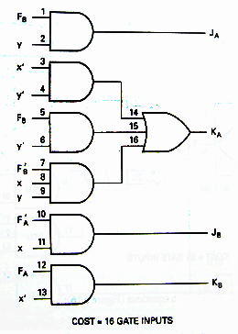
Excitation Realization Cost
J_{A}=F_{B}y
K_{A}=F_{B}’xy+x’y’+F_{B}y’
J_{B}=F_{A}’x
K_{B}=F_{A}x’

Slide 50
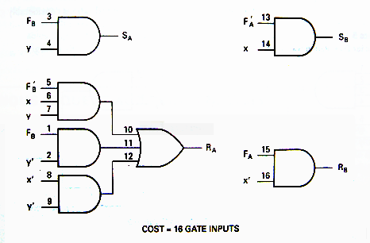
Excitation Realization Cost
S_{A}=F_{B}y
R_{A}=F_{B}’xy+x’y’+F_{B}y’
S_{B}=F_{A}’x
R_{B}=F_{A}x’

Slide 51
Excitation Realization Cost
D_{A}=F_{A}F_{B}’xy’+F_{A}x’y+F_{B}y
D_{B}=F_{A}’F_{B}+F_{A}’x+F_{B}x

Slide 52
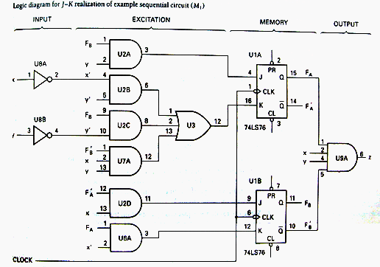
Excitation Realization Cost
X
Y
Z
Z= F_{A}F_{B}’xy
Notes:
在本例中，激励实现的代价J-K和SR相对比D和T触发器要小。

Slide 53
Sequential Circuits’ Analysis

Slide 54
Synchronous Sequential Circuit Analysis
Analysis Pinciples
1. Determine the system variables: input, state, and output.
2. Determine the flip-flop type. Write the characteristic equations.
3. write the excitation equations.
4. write the next state equations.
5. Write the output variable equations.
6. Construct a transition table.
7. Assign symbols to the states and construct a table or state diagram.
8. When possible, construct a timing diagram.
9. Functionality analysis
Notes:
1.确定系统变量：输入变量、状态变量以及输出变量；
2.确定触发器类型，写出特征方程；
3.写出激励方程；
4.写出次态方程；
5.写出输出方程；
6.构造转换表；
7.为每个状态分配相应符号，构造状态图或状态表；
8.画出时序图（波形图）；
9.功能分析。

Slide 55
Analysis Examples
E.g.1: Analysis the following synchronous sequential circuit, suppose the present state is 00, the input sequence is 0000011111, give the timing diagram.
Notes:
1.输入x
2.输出z
3.两个JK触发器负边沿触发

Slide 56
Analysis Examples
1. Determine the system variables: input, state, and output.
input=x
output=Z
state variables=y₁ and y₀
2. Determine the flip-flop type. Write the characteristic equations.
y^{n+1}=Jy^{n}’+k’y^{n}
3. write the excitation equations.
K₀=J₀=1
K₁=J₁=x⊕y₀
Notes:
1.确定系统变量：输入变量、状态变量以及输出变量；
输入变量：x
输出变量：z
状态变量：y1、y0
2.确定触发器类型，写出特征方程；
y^{n+1}=Jy^{n}’+K’y^{n}
3.写出激励方程；

Slide 57
Analysis Examples
4. write the next state equations.
y₁^{n+1}=J₁y₁’+k’y₁ y₁^{n+1}=x’y₁’y₀ +x’y₁y₀’+xy₁’y₀’+xy₁y₀
y₀^{n+1}=J₀y₀’+k₀’y₀ y₀^{n+1}=y₀’
5. Write the output variable equations.
Z=(xy₁’)’=x’+y₁
6. Construct a transition table.
Notes:
4.写出次态方程
5.写出输出方程；
6.构造转换表

Slide 58
Analysis Examples
y₁^{n+1}= x’y₁’y₀ +x’y₁y₀’ +xy₁’y₀’+xy₁y₀
y₀^{n+1}=y₀’
Z=(xy₁’)’=x’+y₁
Y₁^{n+1} K-Map
Y₀^{n+1} K-Map
Z K-Map

Slide 59
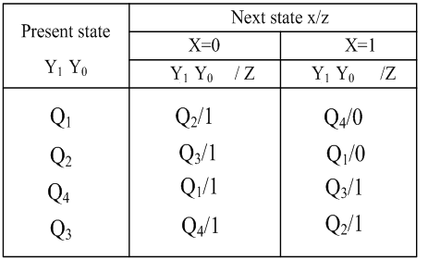
Analysis Examples
7. Assign symbols to the states and construct a table or state diagram.
Q1 | 00
Q2 | 01
Q3 | 10
Q4 | 11
Notes:
7. 为每个状态分配相应符号，构造状态图或状态表

Slide 60
Analysis Examples
8. construct a timing diagram.

Slide 61
Analysis Examples
E.g.2: Analysis the following circuit
Notes:
4个输出Q₁~Q₄
4个D触发器正脉冲触发

Slide 62
Analysis Examples
1. Determine the system variables: input, state, and output.
state variables: Q₁,Q₂,Q₃, and Q₄
2. Determine the flip-flop type. Write the characteristic equations.
Q^{n+1}=D
3. excitation equations.
D₄=Q₃
D₃=Q₂
D₂=Q₁
D₁=Q₄’(Q₃Q₁’)’=Q₄’Q₃’+Q₄’Q₁

Slide 63
Analysis Examples
4. the next state equations.
Q₄^{n+1}=Q₃
Q₃^{n+1}=Q₂
Q₂^{n+1}=Q₁
Q₁^{n+1}=Q₄’Q₃’+Q₄’Q₁

Slide 64
Analysis Examples
5. Construct a transition table.

Slide 65
Analysis Examples
6. Assign symbols to the states and construct a table or state diagram.
Notes:
为每个状态分配相应符号，构造状态图或状态表

Slide 66
Analysis Examples
7. construct a timing diagram.
CP
Q₁
Q₂
Q₃
Q₄
S₀ S₁ S₃ S₇ S₁₅ S₁₄ S₁₂ S₈ S₀

Slide 67
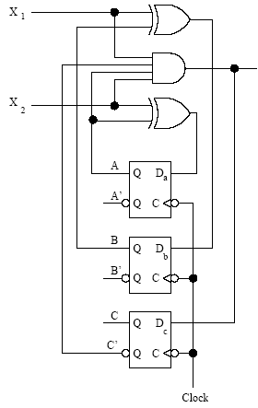
Exercise
Find the transition table and the state table for the Mealy sequential circuit below.
Z

Slide 68
1. Determine the system variables: input, state, and output.
input: x₁,x₂
output: Z
state variable: D_{a} , D_{b} ,D_{c}
2. Determine the flip-flop type. Write the characteristic equations.
Q_{n+1}=D
3. Excitation equations and output equations.
D_{a}=Q_{a}⊕X₂
D_{b}=Q_{b}⊕X₁
D_{c}=X₁X₂Q_{c}’Q_{a}
Z=X₁X₂Q_{c}’Q_{a}

Slide 69
4. write the next state equations.
Q_{a}^{n+1}=Q_{a}X₂’+Q_{a}’X₂
Q_{b}^{n+1}=Q_{b}X₁’+Q_{b}’X₁
Q_{c}^{n+1}=X₁X₂Q_{c}’Q_{a}
5. Construct a transition table.

Slide 70
6. Assign symbols to the states and construct a state table

Slide 71
Construction of State Diagrams
The most challenging part of sequential circuit synthesis is the development of a state diagram from a verbal or written problem statement.
Construction of a state diagram in sequential design is analogous to the construction of a truth table in combinational logic design.
Notes:
时序电路合成过程中，最具挑战性的部分就是从口头或书面的问题描述来形成状态图。
在时序设计中构造状态图类似于在组合逻辑设计中构造真值表。

Slide 72
Example 1: Synchronous Decade Counter
Create the state diagram for a synchronous decade counter. The counter is to count up or down, in binary, depending on the value of a mode control input signal. When the mode control input M=0, the counter is to count up; when M=1, the counter is to count down. The counter is to repeat or cycle; that is to count from 0 to 9 and then start over if M=0 or count down from 9 to 0 if M=1. The counter output y is to be a 1 if counting up and the terminal count is reached. Another output z is to be a 1 at the terminal count if counting down.
Notes:
例1：同步可逆十进制计数器 为同步可逆十进制计数器创建状态图。计数器根据模式控制输入信号的值以二进制的形式向上或向下计数。模式控制输入M=0时，计数器向上计数；M=1时，计数器向下计数。计数器可以重复或循环计数，如果向上计数且达到终止计数值，则计数器输出y为1。如果是向下计数且达到终止计数值，则另一个输出z为1。
分析： 状态个数：10（十进制）
状态转换控制：M=0向上计数，M=1向下计数
输出：y、z

Slide 73
Example 1: Synchronous Decade Counter
Solution:
10 states: 0..9
1 mode control, M=0/M=1，
output y, z
M'
M'
M'
M'
0
1
2
3
4
M/z
M
M
M
M'/y
M
M
M'
M
M
M
M
9
8
7
6
5
M'
M'
M'
M'
Notes:
分析： 状态个数：10（十进制）
状态转换控制：M=0向上计数，M=1向下计数
输出：y、z
Mealy机

Slide 74
Example 2-1: Sequence Detector
Construct a Mealy state diagram that will detect a serial input sequence of 10110. The detection of the required bit pattern can occur in a longer data string and the correct pattern can overlap with another pattern. When the input pattern has been detected, cause an output z to be asserted high.
For example, let the input string be
x = 10110110110
z = 00001001001
Notes:
构造一个可以检测出串行输入序列10110的Mealy状态图。对所规定的位模式的检测能出现在较长的数据串中。正确的模式也可以和另一种模式重叠。输入模式被检测出来后，引起输出z变为高电平。
例如：
对于输入串x = 10110110110
有 z = 00001001001

Slide 75
Example 2-1: Sequence Detector
0/0
0/0
1/0
“1”
“10”
A
B
C
1/0
0/0
Starting state，waiting the first 1
1/0
0/1
0/0
1/0
“1”
“10”
“101”
“10110”
E
D
e.g.：input 10110110110
state BCDECDECDEC
output 00001001001
1/0
“1011”

Slide 76
Example 2-2: Sequence Detector
Design a Mealy serial bit-pattern detector that will detect the input sequence 01010 in a longer bit string. If the pattern is detected, then cause output Q to be active-high. If an 011 bit pattern occurs within the same serial data string, cause output P to be active high. If the 011 pattern occurs, cause the state machine to initialize and start over looking for the 01010 pattern. Overlapping 01010 patterns can occur.
If X = 00110101011101010101 then output
Q = 00000000100000001010
P = 00010000001000000000
Notes:
设计一个可以检测较长位串中的输入序列01010的Mealy串行位模式检测器。如果该位模式被检测到，那么就使输出Q为高有效。如果模式011出现在同样的串行数据串中，使输出P为高态有效。如果模式011出现，则使状态机初始化且重新开始等待01010模式。允许出现重叠的01010模式。
例如：
对于输入串x = 00110101011101010101
有 Q= 00000000100000001010
P = 00010000001000000000

Slide 77
Example 2-2: Sequence Detector
1/P
“011”，resets to state A
0
1
“0”
“01”
“0”
“01”
A
B
C
0
1
0
1/P
0
“011”，resets to state A
“010”
“01”
e.g.：input 00110101011
state：A-B-C-A-B-C-D-E-D-E-A
output：P：0010000001
Q：0000000100
“0101”
E
D
1
0/Q
“01010”

Slide 78
Synchronous Counters

Slide 79
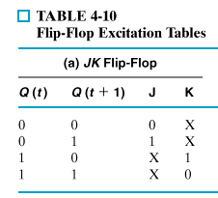
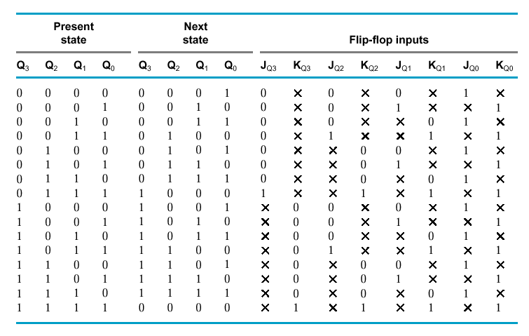
J-K Flip Flop Design of a 4-bit Binary Up Counter
Notes:
用JK触发器实现
Step1:确定输入变量、输出变量；
Step2:确定触发器个数
状态个数:16->需要触发器:4;
Step3:确定触发器类型：JK触发器；
Step4:列出转换表；
Step5:列出激励表；
Step6:写出激励方程，输出方程；
Step7:画出逻辑图。

Slide 80
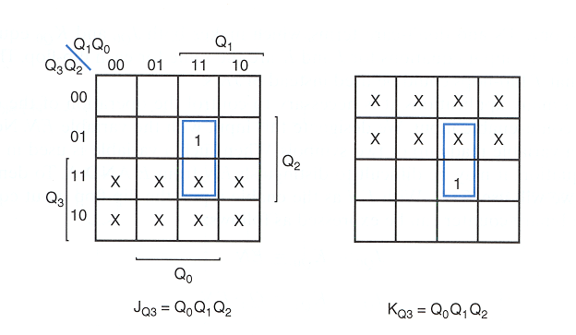

Slide 81
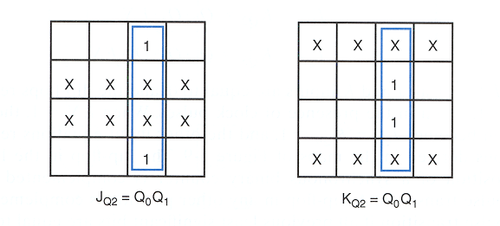

Slide 82
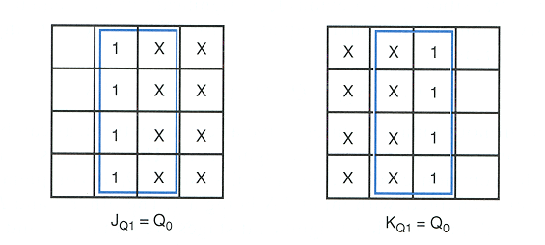
Notes:
Q0的JK不用卡诺图了，非1即X，显然可以设置成全1.

Slide 83
J-K Flip Flop Design of a 4-bit Binary Up Counter
J_{Q0} = 1
K_{Q0} = 1
J_{Q1} = Q₀
K_{Q1} = Q₀
J_{Q2} = Q₀ Q₁
K_{Q2} = Q₀ Q₁
J_{Q3} = Q₀ Q₁ Q₂
K_{Q3} = Q₀ Q₁ Q₂

Slide 84
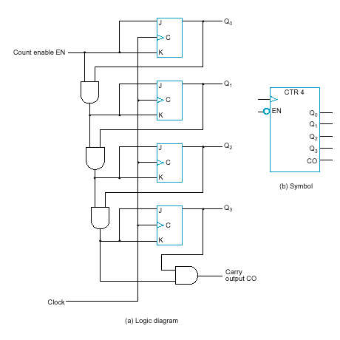
J-K Flip Flop Design of a Binary Up Counter with EN and CO
EN = enable control signal, when 0 counter remains in the same state, when 1 it counts
CO = carry output signal, used to extend the counter to more stages
J_{Q0} = 1 · EN
K_{Q0} = 1 · EN
J_{Q1} = Q₀ · EN
K_{Q1} = Q₀ · EN
J_{Q2} = Q₀ Q₁ · EN
K_{Q2} = Q₀ Q₁ · EN
J_{Q3} = Q₀ Q₁ Q₂ · EN
K_{Q3} = Q₀ Q₁ Q₂ · EN
CO = Q₀ Q₁ Q₂ Q₃ · EN
Notes:
含使能信号和进位输出信号的JK同步二进制计数器
EN控制计数器开始计数
CO用于扩展计数器状态

Slide 85
Synchronous binary counters using D flip-flops
D_{Q0} = Q₀ ⊗ EN
D_{Q1} = Q₁ ⊗ ( Q0 · EN)
D_{Q2} = Q₂ ⊗ ( Q0 Q1 · EN )
D_{Q3} = Q₃ ⊗ ( Q0 Q1 Q2 · EN )
CO = Q₀ Q₁ Q₂ Q₃ · EN
JK-based design calls for 4 AND gates
D-based design calls for 4 AND and 4 XOR gates
JK-FF equations

Slide 86
Summary
BCD Decade Counter
With some additional logic, a binary counter can be converted to a BCD synchronous decade counter. After reaching the count 1001, the counter recycles to 0000.
This gate detects 1001, and causes FF3 to toggle on the next clock pulse. FF0 toggles on every clock pulse. Thus, the count starts over at 0000.
Q₃
Exercise: desigh a BCD Decade Counter
Q₀
Notes:
此处的设计在于，从波形图分析，从0000开始到0111时，Q3需要翻转，再继续，到1001以后，Q3再次需要翻转。故直接得到两个与门相或的结果。
练习要求：采用之前学习的设计模式，自行设计一个同步BCD十进制计数器。
注意：遇到1001以后，下一状态为0000.对于1010~1111的，可以采用任意项。
可以参考J-K Flip Flop Design of a 4-bit Binary Up Counter 的状态表进行设计。 如果按照卡诺图化到最简，则K3和J3可以是不同表达式。会与图中有所区别。
J3=Q2Q1Q0，K3=Q0。

Slide 87
Summary
BCD Decade Counter
Waveforms for the decade counter:
CLK
Q₀
Q₁
Q₂
Q₃

Slide 88
Summary
A 4-bit Synchronous Binary Counter
The 74LS163 is a 4-bit IC synchronous counter with additional features over a basic counter. It has parallel load, a CLR input, two chip enables, and a ripple count output that signals when the count has reached the terminal count.
Data inputs
D₀
D₁
D₂
D₃
CLR
LOAD
ENT
RCO
ENP
CLK
Example waveforms are on the next slide…
Q₀
Q₁
Q₂
Q₃
Data outputs
Notes:
CLR: 清0输入
LOAD：载数信号，在下一个时钟脉冲来临时读取数据输入状态
ENT/ENP：使能，控制计数。
RCO：异步（行波）输出
RCO和使能输入可以用于计数器扩展。

Slide 89
Summary
CLR
LOAD
D₀
Data inputs
D₁
D₂
D₃
CLK
ENP
ENT
Q₀
Data outputs
Q₁
Q₂
Q₃
RCO
12 13 14 15 0 1 2
Count Inhibit
Clear Preset
Notes:
CLR: 清0输入
LOAD：载数信号，在下一个时钟脉冲来临时读取数据输入状态
ENT/ENP：使能输入
RCO：异步（行波）输出
CLR信号有效，在时钟脉冲到来后，全部清0，LOAD信号有效，下一个时钟脉冲，读入D3到D0，使能信号有效，开始计数。

Slide 90
Summary
Up/Down Synchronous Counters(可逆同步计数器)
An up/down counter is capable of progressing in either direction depending on a control input.
UP
Q₀.UP
HIGH
FF0
FF1
FF2
Q₂
J₀
Q₀
J₁
Q₁
J₂
UP/DOWN
C
C
C
Q₀
Q₁
Q₂
K₀
K₁
K₂
DOWN
Q₀.DOWN
CLK
Example waveforms from Multisim are on the next slide…

Slide 91
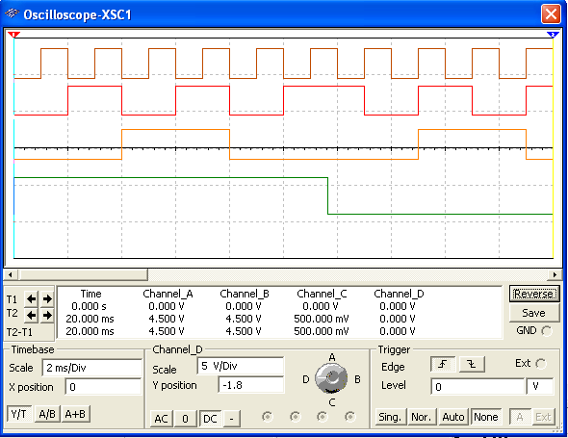
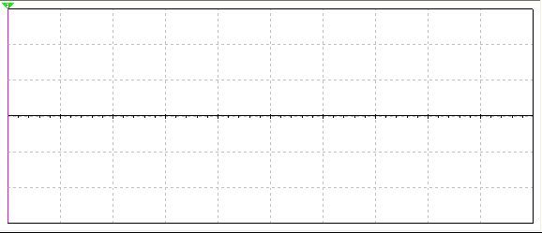
Summary
Up/Down Synchronous Counters*
Q₀
Q₁
Q₂
UP/DOWN
Count up
Count down

Slide 92
Summary
Up/Down Synchronous Counters
D₀
D₁
D₂
D₃
Data inputs
The 74HC190 is a high speed CMOS synchronous up/down decade counter with parallel load capability. It also has a active LOW ripple clock output (RCO) and a MAX/MIN output when the terminal count is reached.
74HC190
CTEN
MAX/MIN
D/U
CTR DIV 10
LOAD
CLK
C
RCO
Q₀
Q₁
Q₂
Q₃
Data outputs
D₀
D₁
D₂
D₃
Data inputs
The 74HC191 has the same inputs and outputs but is a synchronous up/down binary counter.
74HC191
CTEN
MAX/MIN
D/U
CTR DIV 16
LOAD
CLK
C
RCO
Q₀
Q₁
Q₂
Q₃
Data outputs

Slide 93
Summary
Cascaded counters(级联计数器)
Cascading is a method of achieving higher-modulus counters. For synchronous IC counters, the next counter is enabled only when the terminal count of the previous stage is reached.
HIGH
Counter 1
Counter 2
f_{out}
CTEN
TC
CTEN
TC
CTR DIV 16
CTR DIV 16
CLK
C
Q₀
Q₂
Q₁
Q₃
C
Q₀
Q₂
Q₁
Q₃
f_{in}
Example
What is the modulus of the cascaded DIV 16 counters?
If f_{in} =100 kHz, what is f_{out}?
Solution
a) Each counter divides the frequency by 16. Thus the modulus is 16² = 256.
b) The output frequency is 100 kHz/256 = 391 Hz
Notes:
CTEN:使能输入
计数器1每完成一次计数循环，输出一次TC信号使得计数器2开始计数一次
级联效果：10*10=100

Slide 94
Summary
Counter Decoding(计数器译码)
Decoding is the detection of a binary number and can be done with an AND gate.
Question
What number is decoded by this gate?

Slide 95
Summary
Partial Decoding(部分译码)
The decade counter shown previously incorporates partial decoding (looking at only the MSB and the LSB) to detect 1001. This was possible because this is the first occurrence of this combination in the sequence.
Detects 1001 by looking only at two bits

Slide 96
Summary
Resetting the Count with a Decoder
The divide-by-60 counter in the text also uses partial decoding to clear the tens count when a 6 was detected.
The divide characteristic illustrated here is a good way to obtain a lower frequency using a counter. For example, the 60 Hz power line can be converted to 1 Hz.

Slide 97
Summary
8.6 Counter Decoding
Example
Show how to decode state 5 with an active LOW output.
Solution
Notice that a NAND gate was used to give the active LOW output.

Slide 98

Control Signal Generation by Decoding Counter Outputs
Using counter to realize following control signals
74LS393:
Dual 4-bit Binary Counter.
双四位二进制计数器

Slide 99

Control Signal Generation by Decoding Counter Outputs
E₁ = f(Q₃,Q₂,Q₁,Q₀) = m(2,3,8,9,10,11)
E₂ = f(Q₃,Q₂,Q₁,Q₀) = m(5)
E₃ = f(Q₃,Q₂,Q₁,Q₀) = m(9)

Slide 100

Control Signal Generation by Decoding Counter Outputs

Slide 101

A Counter Application: Digital Clock(数字时钟)

Slide 102
Arbitrary Sequence Counter (任意序列计数器)
Given an arbitrary sequence, design a counter that will generate this sequence.
Procedure:
Derive state table/diagram based on give sequence
Simplify (using K-maps, etc)
Draw logic diagram
Notes:
对任意序列，设计一个计数器来产生这个序列。
过程
根据序列生成状态表/状态图
化简（如：用卡诺图）
绘制逻辑图

Slide 103
Example
Use D-FFs to draw the logic diagram for sequence generator (counter) for: 0 → 7 → 6 → 1 → 0 (000 → 111 → 110 → 001 → 000)
Notes:
示例：使用D触发器来产生一个序列 0 → 7 → 6 → 1 → 0 (000 → 111 → 110 → 001 → 000) 序列结束时，输出z=1。
所示表格为激励表

Slide 104
Example
D₃ K-Map
D₂ K-Map
D₁ K-Map
D₃=Q₃’Q₁’+Q₃Q₁
D₂=Q₃’Q₁’+Q₃Q₁
D₁=Q₁’
Z= Q₃’Q₁
Z K-Map

Slide 105
Example
D₃=Q₃’Q₁’+Q₃Q₁
D₂=Q₃’Q₁’+Q₃Q₁
D₁=Q₁’
Z= Q₃’Q₁

Slide 106
Selected Key Terms
Asynchronous
Modulus
Synchronous
Terminal count
State machine
Cascade
Not occurring at the same time.
The number of unique states through which a counter will sequence.
Occurring at the same time.
The final state in a counter’s sequence.
A logic system exhibiting a sequence of states or values.
To connect “end-to-end” as when several counters are connected from the terminal count output of one to the enable input of the next counter.

Slide 107
Homework
判断题、自测题：(自愿完成)
8.1节：2
8.2节：8
8.3节：12
8.4节：16、18、20
8.5-8.7节：23、26、32

Slide 108

Quiz
a
1. The counter shown below is an example of
a. an asynchronous counter
b. a BCD counter
c. a synchronous counter
d. none of the above
HIGH
J₀
Q₀
J₁
Q₁
J₂
Q₂
CLK
C
C
C
Q₀
Q₁
K₀
K₁
K₂
© 2008 Pearson Education

Slide 109
Quiz
d
The Q₀ output of the counter shown
a. is present before Q₁ or Q₂
b. changes on every clock pulse
c. has a higher frequency than Q₁ or Q₂
d. all of the above
HIGH
J₀
Q₀
J₁
Q₁
J₂
Q₂
CLK
C
C
C
Q₀
Q₁
K₀
K₁
K₂
© 2008 Pearson Education

Slide 110
Quiz
c
3. To cause a D flip-flop to toggle, connect the
a. clock to the D input
b. Q output to the D input
c. Q output to the D input
d. clock to the preset input
© 2008 Pearson Education

Slide 111

Quiz
d
4. The 7493A asynchronous counter diagram is shown (J’s and K’s are HIGH.) To make the count have a modulus of 16, connect
a. Q₀ to RO(1) and RO(2) to
b. Q₃ to RO(1) and RO(2)
c. CLK A and CLK B together
d. Q₀ to CLK B
© 2008 Pearson Education

Slide 112
Quiz
b
5. Assume Q₀ is LOW. The next clock pulse will cause
a. FF1 and FF2 to both toggle
b. FF1 and FF2 to both latch
c. FF1 to latch; FF2 to toggle
d. FF1 to toggle; FF2 to latch
FF0
FF1
FF2
LOW
© 2008 Pearson Education

Slide 113
Quiz
c
6. A 4-bit binary counter has a terminal count of
a. 4
b. 10
c. 15
d. 16
© 2008 Pearson Education

Slide 114
Quiz
a
7. Assume the clock for a 4-bit binary counter is 80 kHz. The output frequency of the fourth stage (Q₃) is
a. 5 kHz
b. 10 kHz
c. 20 kHz
d. 320 kHz
© 2008 Pearson Education

Slide 115

Quiz
b
8. A 3-bit count sequence is shown for a counter (Q₂ is the MSB). The sequence is
a. 0-1-2-3-4-5-6-7-0 (repeat)
b. 0-1-3-2-6-7-5-4-0 (repeat)
c. 0-2-4-6-1-3-5-7-0 (repeat)
d. 0-4-6-2-3-7-5-1-0 (repeat)
Q₀
Q₁
Q₂
© 2008 Pearson Education

Slide 116
Quiz
b
9. FF2 represents the MSB. The counts that are being decoded by the 3-input AND gates are
a. 2 and 3
b. 3 and 6
c. 2 and 5
d. 5 and 6
© 2008 Pearson Education

Slide 117
Quiz
d
10. Assume the input frequency (f_{in}) is 256 Hz. The output frequency (f_{out}) will be
a. 16 Hz
b. 1 kHz
c. 65 kHz
d. none of the above
HIGH
Counter 1
Counter 2
f_{out}
CTEN
TC
CTEN
TC
CTR DIV 16
CTR DIV 16
CLK
C
Q₀
Q₂
Q₁
Q₃
C
Q₀
Q₂
Q₁
Q₃
f_{in}
© 2008 Pearson Education

Slide 118
Quiz
Answers:
1. a
2. d
3. c
4. d
5. b
6. c
7. a
8. b
9. b
10. d

Slide 119
HOMEWORK
1. Design a modulu-13 binary counter.
1) asynchronous
2) synchronous
2. Design a synchronous counter to produce the 3-bit gray code sequences:000,001,011,010,110,111,101,100,000…

